Slide 1
Quick-Sort
7 4 9 6 2 → 2 4 6 7 9
4 2 → 2 4
7 9 → 7 9
2 → 2
9 → 9
Quick-Sort
Notes:
Quick-Sort

Slide 2
Outline and Reading
Quick-sort
  Algorithm
  Partition step
  Quick-sort tree
  Execution example
Analysis of quick-sort
In-place quick-sort
Summary of sorting algorithms
Quick-Sort

Slide 3
Quick-Sort
Quick-sort is a randomized sorting algorithm based on the divide-and-conquer paradigm:
  Divide: pick a random element x (called pivot) and partition S into
    L elements less than x
    E elements equal x
    G elements greater than x
  Recur: sort L and G
  Conquer: join L, E and G
x
x
L
G
E
x
Quick-Sort

Slide 4
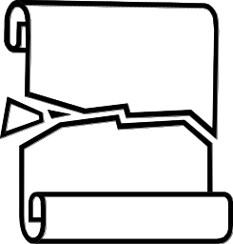
Partition
We partition an input sequence as follows:
  We remove, in turn, each element y from S and
  We insert y into L, E or G, depending on the result of the comparison with the pivot x
Each insertion and removal is at the beginning or at the end of a sequence, and hence takes O(1) time
Thus, the partition step of quick-sort takes O(n) time
Algorithm partition(S, p)
Input sequence S, position p of pivot
Output subsequences L, E, G of the
elements of S less than, equal to,
or greater than the pivot, resp.
L, E, G ← empty sequences
  x ← S.remove(p)
  while ¬S.isEmpty()
  y ← S.remove(S.first())
  if y < x
  L.insertLast(y)
  else if y = x
  E.insertLast(y)
  else { y > x }
  G.insertLast(y)
  return L, E, G
Quick-Sort

Slide 5
Quick-Sort Tree
An execution of quick-sort is depicted by a binary tree
  Each node represents a recursive call of quick-sort and stores
    Unsorted sequence before the execution and its pivot
    Sorted sequence at the end of the execution
  The root is the initial call
  The leaves are calls on subsequences of size 0 or 1
7 4 9 6 2 → 2 4 6 7 9
4 2 → 2 4
7 9 → 7 9
2 → 2
9 → 9
Quick-Sort

Slide 6
Execution Example
Pivot selection
7 2 9 4 3 7 6 1 → 1 2 3 4 6 7 8 9
7 2 9 4 → 2 4 7 9
3 8 6 1 → 1 3 8 6
2 → 2
9 4 → 4 9
3 → 3
8 → 8
9 → 9
4 → 4
Quick-Sort

Slide 7
Execution Example (cont.)
Partition, recursive call, pivot selection
7 2 9 4 3 7 6 1 → 1 2 3 4 6 7 8 9
2 4 3 1 → 2 4 7 9
3 8 6 1 → 1 3 8 6
2 → 2
9 4 → 4 9
3 → 3
8 → 8
9 → 9
4 → 4
Quick-Sort

Slide 8
Execution Example (cont.)
Partition, recursive call, base case
7 2 9 4 3 7 6 1 → → 1 2 3 4 6 7 8 9
2 4 3 1 →→ 2 4 7
3 8 6 1 → 1 3 8 6
1 → 1
9 4 → 4 9
3 → 3
8 → 8
9 → 9
4 → 4
Quick-Sort

Slide 9
Execution Example (cont.)
Recursive call, …, base case, join
7 2 9 4 3 7 6 1 → 1 2 3 4 6 7 8 9
2 4 3 1 → 1 2 3 4
3 8 6 1 → 1 3 8 6
1 → 1
4 3 → 3 4
3 → 3
8 → 8
9 → 9
4 → 4
Quick-Sort

Slide 10
Execution Example (cont.)
Recursive call, pivot selection
7 2 9 4 3 7 6 1 → 1 2 3 4 6 7 8 9
2 4 3 1 → 1 2 3 4
7 9 7 1 → 1 3 8 6
1 → 1
4 3 → 3 4
8 → 8
9 → 9
9 → 9
4 → 4
Quick-Sort

Slide 11
Execution Example (cont.)
Partition, …, recursive call, base case
7 2 9 4 3 7 6 1 → 1 2 3 4 6 7 8 9
2 4 3 1 → 1 2 3 4
7 9 7 1 → 1 3 8 6
1 → 1
4 3 → 3 4
8 → 8
9 → 9
9 → 9
4 → 4
Quick-Sort

Slide 12
Execution Example (cont.)
Join, join
7 2 9 4 3 7 6 1 → 1 2 3 4 6 7 7 9
2 4 3 1 → 1 2 3 4
7 9 7 → 17 7 9
1 → 1
4 3 → 3 4
8 → 8
9 → 9
9 → 9
4 → 4
Quick-Sort

Slide 13
Worst-case Running Time
The worst case for quick-sort occurs when the pivot is the unique minimum or maximum element
One of L and G has size n − 1 and the other has size 0
The running time is proportional to the sum
n + (n − 1) + … + 2 + 1
Thus, the worst-case running time of quick-sort is O(n²)
depth | time
0 | n
1 | n − 1
… | …
n − 1 | 1
…
Quick-Sort

Slide 14
Expected Running Time
Consider a recursive call of quick-sort on a sequence of size s
  Good call: the sizes of L and G are each less than 3s/4
  Bad call: one of L and G has size greater than 3s/4
A call is good with probability ?????
7 2 9 4 3 7 6 1 9
7 2 9 4 3 7 6 1
2 4 3 1
7 9 7 1 → 1
1
7 2 9 4 3 7 6
Good call
Bad call
Quick-Sort

Slide 15
Expected Running Time
Consider a recursive call of quick-sort on a sequence of size s
  Good call: the sizes of L and G are each less than 3s/4
  Bad call: one of L and G has size greater than 3s/4
A call is good with probability 1/2
  1/2 of the possible pivots cause good calls:
7 2 9 4 3 7 6 1 9
7 2 9 4 3 7 6 1
2 4 3 1
7 9 7 1 → 1
1
7 2 9 4 3 7 6
Good call
Bad call
1 2 3 4 5 6 7 8 9 10 11 12 13 14 15 16
Bad pivots
Good pivots
Bad pivots
Quick-Sort

Slide 16
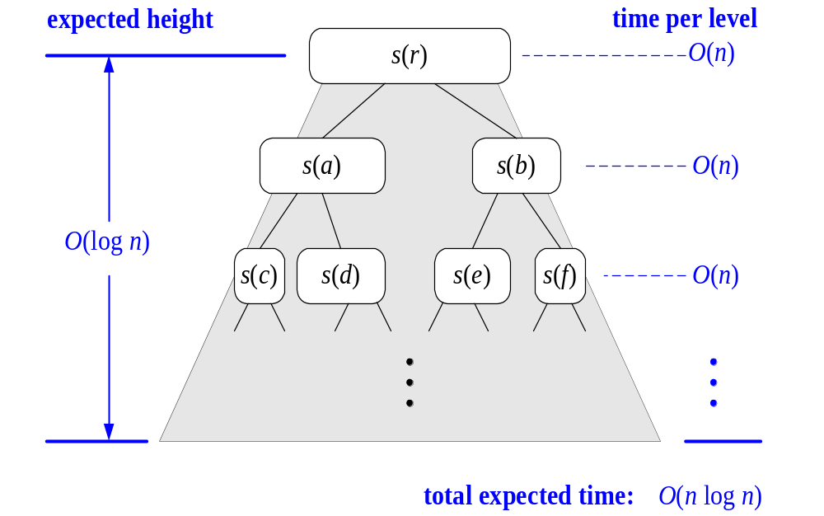
Expected Running Time, Part 2
For a node of depth i,
The size of the input sequence for the current call is at most (3/4)^{i.}n
Probabilistic Fact: The expected number of coin tosses required in order to get k heads is 2k
Therefore, we have
  The expected height of the quick-sort tree is O(log n)
The amount or work done at the nodes of the same depth is O(n)
Thus, the expected running time of quick-sort is O(n log n)
Quick-Sort

Slide 17

In-Place Quick-Sort
Quick-sort can be implemented to run in-place
In the partition step, we use replace operations to rearrange the elements of the input sequence such that
  the elements less than the pivot have rank less than h
  the elements equal to the pivot have rank between h and k
  the elements greater than the pivot have rank greater than k
The recursive calls consider
  elements with rank less than h
  elements with rank greater than k
Algorithm inPlaceQuickSort(S, l, r)
Input sequence S, ranks l and r
Output sequence S with the
elements of rank between l and r
rearranged in increasing order
if l ≥ r
  return
  i ← a random integer between l and r
  x ← S.elemAtRank(i)
  (h, k) ← inPlacePartition(x)
  inPlaceQuickSort(S, l, h − 1)
  inPlaceQuickSort(S, k + 1, r)
Quick-Sort

Slide 18
Summary of Sorting Algorithms
Algorithm | Time | Notes
selection-sort | O(n²) | in-place slow (good for small inputs)
insertion-sort | O(n²) | in-place slow (good for small inputs)
quick-sort | O(n log n) expected | in-place, randomized fastest (good for large inputs)
heap-sort | O(n log n) | in-place fast (good for large inputs)
merge-sort | O(n log n) | sequential data access fast (good for huge inputs)
Quick-Sort

